Slide 1
Python Decorators
Anju Munoth

Slide 2
Functions in python
In Python, functions are the first class objects, which means that –
Functions are objects; they can be referenced to, passed to a variable and returned from other functions as well.
Functions can be defined inside another function and can also be passed as argument to another function.

Slide 3
Decorators in python
Python has an interesting feature called decorators to add functionality to an existing code.
Also called metaprogramming because a part of the program tries to modify another part of the program at compile time.
A decorator takes in a function, adds some functionality and returns it.
A decorator is a design pattern tool in Python for wrapping code around functions or classes (defined blocks).
This design pattern allows a programmer to add new functionality to existing functions or classes without modifying the existing structure

Slide 4
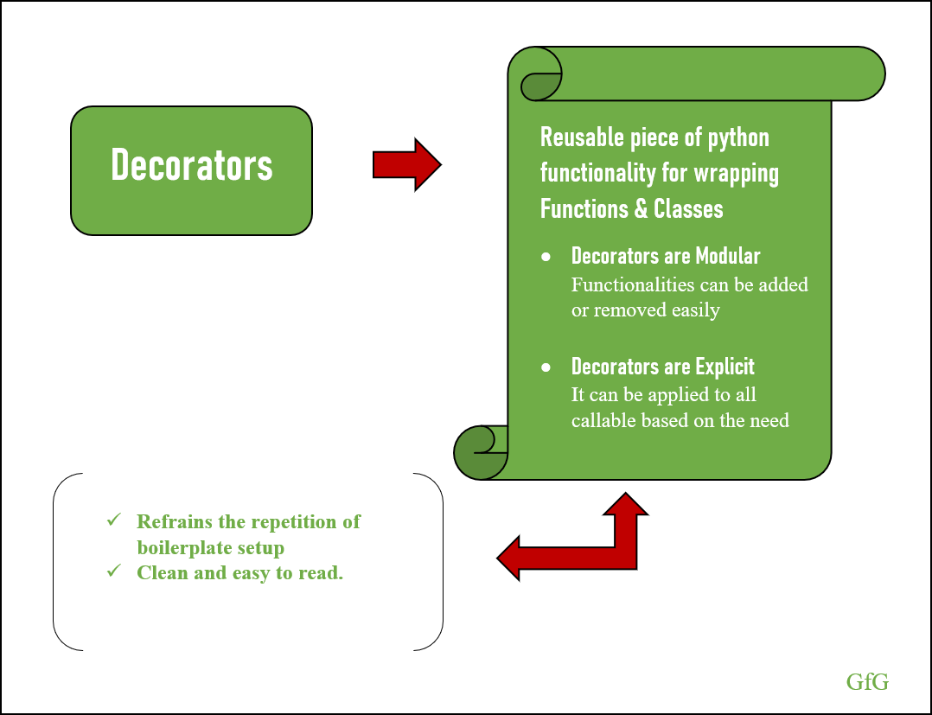

Slide 5
Higher order functions
functions that take other functions as arguments are also called higher order functions. Here is an example of such a function.
def inc(x):
return x + 1
def dec(x):
return x - 1
def operate(func, x):
result = func(x)
return result
We invoke the function as follows.
>>> operate(inc,3)
4
>>> operate(dec,3)
2

Slide 6
Understanding Decorators
Functions and methods are called callable as they can be called.
Any object which implements the special __call__() method is termed callable.
A decorator is a function that takes another function as an argument, does some actions, and then returns the argument based on the actions performed.
Since functions are first-class object in Python, they can be passed as arguments to another functions.
Hence we can say that a decorator is a callable that accepts and returns a callable.

Slide 7
def make_pretty(func):
def inner():
print("I got decorated")
func()
return inner
def ordinary():
print("I am ordinary")
On running the code,
>>> ordinary()
I am ordinary
>>> # let's decorate this ordinary function
>>> pretty = make_pretty(ordinary)
>>> pretty()
I got decorated
I am ordinary
In the example shown above, make_pretty() is a decorator.
In the assignment step:
pretty = make_pretty(ordinary)
The function ordinary() got decorated and the returned function was given the name pretty.

Slide 8
Decorators
can see that the decorator function added some new functionality to the original function.
This is similar to packing a gift.
The decorator acts as a wrapper.
The nature of the object that got decorated (actual gift inside) does not alter.
But now, it looks pretty (since it got decorated).
Generally, we decorate a function and reassign it as,
ordinary = make_pretty(ordinary).
This is a common construct and for this reason, Python has a syntax to simplify this.
We can use the @ symbol along with the name of the decorator function and place it above the definition of the function to be decorated

Slide 9
Example
@make_pretty
def ordinary():
print("I am ordinary")
is equivalent to
def ordinary():
print("I am ordinary")
ordinary = make_pretty(ordinary)
This is just a syntactic sugar to implement decorators.

Slide 10
Decorating Functions with Parameters
def divide(a, b):
return a/b
This function has two parameters, a and b.
Will give an error if we pass in b as 0.
>>> divide(2,5)
0.4
>>> divide(2,0)
Traceback (most recent call last):
...
ZeroDivisionError: division by zero

Slide 11
Decorating Functions with Parameters
def smart_divide(func):
def inner(a, b):
print("I am going to divide", a, "and", b)
if b == 0:
print("Whoops! cannot divide")
return
return func(a, b)
return inner
@smart_divide
def divide(a, b):
print(a/b)
>>> divide(2,5)
I am going to divide 2 and 5
0.4
>>> divide(2,0)
I am going to divide 2 and 0
Whoops! cannot divide

Slide 12
def reverse_decorator(function):
def reverse_wrapper():
make_reverse = "".join(reversed(function()))
return make_reverse
return reverse_wrapper
@reverse_decorator
def say_hi():
return 'Hi George'
print(say_hi())
Output:
egroeG iH

Slide 13
Decorators
Notice that parameters of the nested inner() function inside the decorator is the same as the parameters of functions it decorates.
Taking this into account, now we can make general decorators that work with any number of parameters.
In Python, this magic is done as function(*args, **kwargs).
In this way, args will be the tuple of positional arguments and kwargs will be the dictionary of keyword arguments
An example of such a decorator will be:
def works_for_all(func):
def inner(*args, **kwargs):
print("I can decorate any function")
return func(*args, **kwargs)
return inner

Slide 14
Chaining Decorators in Python
Multiple decorators can be chained in Python.
A function can be decorated multiple times with different (or same) decorators.
Simply place the decorators above the desired function
One important thing to note here is the order of the decorator applied is important, which is applied from bottom to top

Slide 15
def star(func):
def inner(*args, **kwargs):
print("*" * 30)
func(*args, **kwargs)
print("*" * 30)
return inner
def percent(func):
def inner(*args, **kwargs):
print("%" * 30)
func(*args, **kwargs)
print("%" * 30)
return inner
@star
@percent
def printer(msg):
print(msg)
printer("Hello")
Output
******************************
%%%%%%%%%%%%%%%%%%%%%%%%%%%%%%
Hello
%%%%%%%%%%%%%%%%%%%%%%%%%%%%%%
******************************

Slide 16
Single Function and Multiple Decorator
def reverse_decorator(function):
def reverse_wrapper():
make_reverse = "".join(reversed(function()))
return make_reverse
return reverse_wrapper
def uppercase_decorator(function):
def uppercase_wrapper():
var_uppercase = function().upper()
return var_uppercase
return uppercase_wrapper
@uppercase_decorator
@reverse_decorator
def say_hi():
return 'hi george'
print(say_hi())
Output:
EGROEG IH
Here the string is reversed first and foremost, and secondarily it converts to uppercase

Slide 17
def count_calls(func):
def wrapper_count_calls(*args, **kwargs):
wrapper_count_calls.num_calls += 1
print(f"Call {wrapper_count_calls.num_calls} of {func.__name__!r}")
return func(*args, **kwargs)
wrapper_count_calls.num_calls = 0
return wrapper_count_calls
@count_calls
def say_hello():
print("Hello!")
say_hello()
say_hello()
Call 1 of 'say_hello'
Hello!
Call 2 of 'say_hello'
Hello!

Slide 18
Use cases of decoraotors
The standard library provides many modules that include decorators and many Python tools and frameworks that make use of decorators. Few examples are:
Can use @classmethod or @staticmethod decorator for creating a method without creating an instance
The mock module permits the use of @mock.patch or @mock.patch.object as a decorator which is used for unit testing.
Common tools such as Django (uses @login_required) for setting login privileges and Flask (uses @app.route) for function registry uses decorators.
To identify a function as an asynchronous task Celery uses @task decorator.

Slide 19
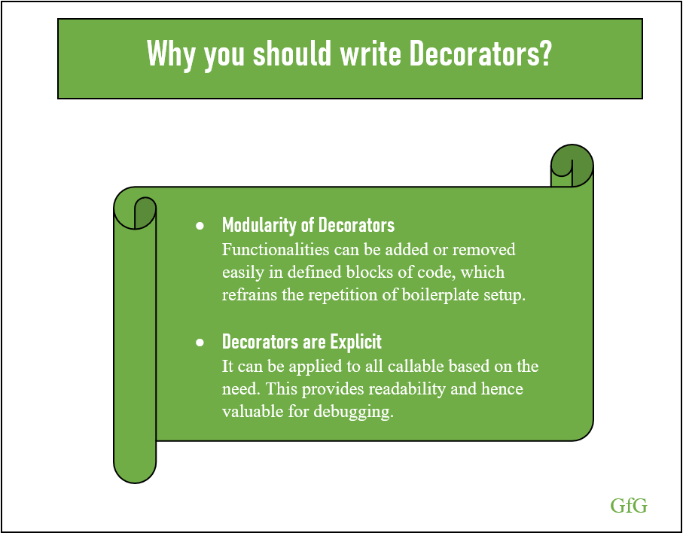

Slide 20
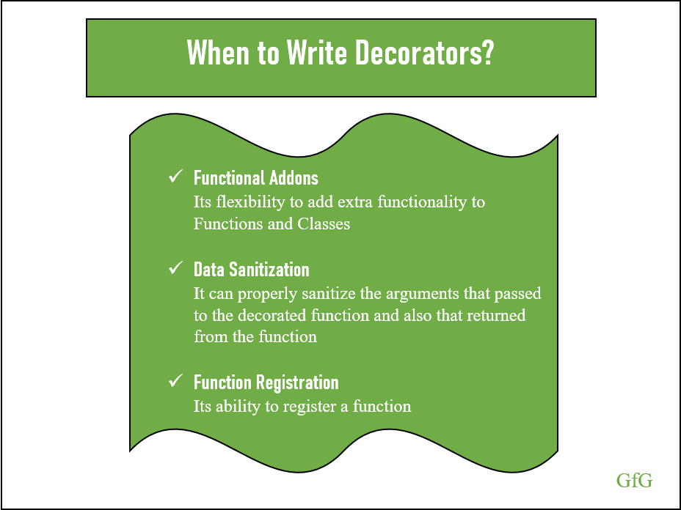

Slide 21
Decorating Classes
Two different ways you can use decorators on classes.
First- can decorate the methods of a class.
Some commonly used decorators that are even built-ins in Python are @classmethod, @staticmethod, and @property.
The @classmethod and @staticmethod decorators are used to define methods inside a class namespace that are not connected to a particular instance of that class.
The @property decorator is used to customize getters and setters for class attributes
Second - decorate the whole class.
Writing a class decorator is very similar to writing a function decorator.
The only difference is that the decorator will receive a class and not a function as an argument

Slide 22
Classes as Decorators
For a class instance to be callable, you implement the special .__call__() method
a typical implementation of a decorator class needs to implement .__init__() and .__call__()

Slide 23
class Counter:
def __init__(self, start=0):
self.count = start
def __call__(self):
self.count += 1
print(f"Current count is {self.count}")
The .__call__() method is executed each time you try to call an instance of the class:
>>> counter = Counter()
>>> counter()
Current count is 1
>>> counter()
Current count is 2
>>> counter.count
2

Slide 24
class CountCalls:
def __init__(self, func):
self.func = func
self.num_calls = 0
def __call__(self, *args, **kwargs):
self.num_calls += 1
print(f"Call {self.num_calls} of {self.func.__name__!r}")
return self.func(*args, **kwargs)
@CountCalls
def say_thanku():
print("Thank u!")
say_thanku()
say_thanku()
The .__init__() method must store a reference to the function and can do any other necessary initialization. The .__call__() method will be called instead of the decorated function

Slide 25
Creating Singletons
A singleton is a class with only one instance.
There are several singletons in Python that you use frequently, including None, True, and False.
It is the fact that None is a singleton that allows you to compare for None using the is keyword

Slide 26
The following @singleton decorator turns a class into a singleton by storing the first instance of the class as an attribute. Later attempts at creating an instance simply return the stored instance
def singleton(cls):
"""Make a class a Singleton class (only one instance)"""
def wrapper_singleton(*args, **kwargs):
if not wrapper_singleton.instance:
wrapper_singleton.instance = cls(*args, **kwargs)
return wrapper_singleton.instance
wrapper_singleton.instance = None
return wrapper_singleton
@singleton
class TheOne:
pass
first_one = TheOne()
another_one = TheOne()
print(id(first_one))
print(id(another_one))
print(first_one is another_one)
2414385761776
2414385761776
True

Slide 27
Python Design Patterns
Design patterns are a common way of solving well known problems. Two main principles are in the bases of the design patterns defined by the GOF:
Program to an interface not an implementation.
Favor object composition over inheritance.
Behavioral Patterns
Behavioural Patterns involve communication between objects, how objects interact and fulfil a given task.
According to GOF principles, there are a total of 11 behavioral patterns in Python: Chain of responsibility, Command, Interpreter, Iterator, Mediator, Memento, Observer, State, Strategy, Template, Visitor.

Slide 28
Proxy design pattern
proxy design pattern includes a new object, which is called “Proxy” in place of an existing object which is called the “Real Subject”.
The proxy object created of the real subject must be on the same interface in such a way that the client should not get any idea that proxy is used in place of the real object.
Requests generated by the client to the proxy are passed through the real subject.

Slide 29
class Image:
def __init__( self, filename ):
self._filename = filename
def load_image_from_disk( self ):
print("loading " + self._filename )
def display_image( self ):
print("display " + self._filename)
class Proxy:
def __init__( self, subject ):
self._subject = subject
self._proxystate = None
class ProxyImage( Proxy ):
def display_image( self ):
if self._proxystate == None:
self._subject.load_image_from_disk()
self._proxystate = 1
print("display " + self._subject._filename )
proxy_image1 = ProxyImage ( Image("HiRes_10Mb_Photo1") )
proxy_image2 = ProxyImage ( Image("HiRes_10Mb_Photo2") )
proxy_image1.display_image() # loading necessary
proxy_image1.display_image() # loading unnecessary
proxy_image2.display_image() # loading necessary
proxy_image2.display_image() # loading unnecessary
proxy_image1.display_image() # loading unnecessary
Output:
loading HiRes_10Mb_Photo1
display HiRes_10Mb_Photo1
display HiRes_10Mb_Photo1
loading HiRes_10Mb_Photo2
display HiRes_10Mb_Photo2
display HiRes_10Mb_Photo2
display HiRes_10Mb_Photo1

Slide 30
Python Design Patterns - Observer
objects are represented as observers that wait for an event to trigger.
An observer attaches to the subject once the specified event occurs.
As the event occurs, the subject tells the observers that it has occurred.
Observer is a behavioral design pattern that lets you define a subscription mechanism to notify multiple objects about any events that happen to the object they’re observing.

Slide 31
Imagine that you have two types of objects: a Customer and a Store. The customer is very interested in a particular brand of product (say, it’s a new model of the iPhone) which should become available in the store very soon.
The customer could visit the store every day and check product availability. But while the product is still en route, most of these trips would be pointless.

Slide 32
object that has some interesting state is often called subject, but since it’s also going to notify other objects about the changes to its state, we’ll call it publisher.
All other objects that want to track changes to the publisher’s state are called subscribers.
The Observer pattern suggests that you add a subscription mechanism to the publisher class so individual objects can subscribe to or unsubscribe from a stream of events coming from that publisher.

Slide 33
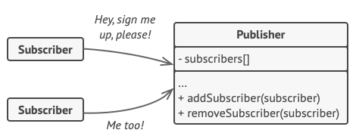
A subscription mechanism lets individual objects subscribe to event notifications.

Slide 34
class SubscriberOne:
def __init__(self, name):
self.name = name
def update(self, message):
print('{} got message "{}"'.format(self.name, message))
class SubscriberTwo:
def __init__(self, name):
self.name = name
def receive(self, message):
print('{} got message "{}"'.format(self.name, message))
class Publisher:
def __init__(self):
self.subscribers = dict()
def register(self, who, callback=None):
if callback == None:
callback = getattr(who, 'update')
self.subscribers[who] = callback
def unregister(self, who):
del self.subscribers[who]
def dispatch(self, message):
for subscriber, callback in self.subscribers.items():
callback(message)

Slide 35
pub = Publisher()
bob = SubscriberOne('Bob')
alice = SubscriberTwo('Alice')
john = SubscriberOne('John')
pub.register(bob, bob.update)
pub.register(alice, alice.receive)
pub.register(john)
pub.dispatch("It's lunchtime!")
pub.unregister(john)
pub.dispatch("Time for dinner")
Bob got message "It's lunchtime!"
Alice got message "It's lunchtime!"
John got message "It's lunchtime!"
Bob got message "Time for dinner"
Alice got message "Time for dinner"

Slide 36
Abstract Factory
Abstract Factory is a creational design pattern that lets you produce families of related objects without specifying their concrete classes.
Abstract Factory defines an interface for creating all distinct products but leaves the actual product creation to concrete factory classes.
Each factory type corresponds to a certain product variety.
The client code calls the creation methods of a factory object instead of creating products directly with a constructor call (new operator).
Since a factory corresponds to a single product variant, all its products will be compatible.
Client code works with factories and products only through their abstract interfaces. This lets the client code work with any product variants, created by the factory object. You just create a new concrete factory class and pass it to the client code.

Slide 37
Abstract Factory
Imagine that you’re creating a furniture shop simulator. Your code consists of classes that represent:
A family of related products, say: Chair + Sofa + CoffeeTable.
Several variants of this family. For example, products Chair + Sofa + CoffeeTable are available in these variants: Modern, Victorian, ArtDeco.
need a way to create individual furniture objects so that they match other objects of the same family. Customers get quite mad when they receive non-matching furniture.
The first thing the Abstract Factory pattern suggests is to explicitly declare interfaces for each distinct product of the product family (e.g., chair, sofa or coffee table).
Then you can make all variants of products follow those interfaces. For example, all chair variants can implement the Chair interface; all coffee table variants can implement the CoffeeTable interface, and so on.

Slide 38
class Window:
__toolkit = ""
__purpose = ""
def __init__(self, toolkit, purpose):
self.__toolkit = toolkit
self.__purpose = purpose
def getToolkit(self):
return self.__toolkit
def getType(self):
return self.__purpose

Slide 39
class GtkToolboxWindow(Window):
def __init__(self):
Window.__init__(self, "Gtk", "ToolboxWindow")
class GtkLayersWindow(Window):
def __init__(self):
Window.__init__(self, "Gtk", "LayersWindow")
class GtkMainWindow(Window):
def __init__(self):
Window.__init__(self, "Gtk", "MainWindow")
class QtToolboxWindow(Window):
def __init__(self):
Window.__init__(self, "Qt", "ToolboxWindow")
class QtLayersWindow(Window):
def __init__(self):
Window.__init__(self, "Qt", "LayersWindow")
class QtMainWindow(Window):
def __init__(self):
Window.__init__(self, "Qt", "MainWindow")

Slide 40
# Abstract factory class
class UIFactory:
def getToolboxWindow(self): pass
def getLayersWindow(self): pass
def getMainWindow(self): pass
class GtkUIFactory(UIFactory):
def getToolboxWindow(self):
return GtkToolboxWindow()
def getLayersWindow(self):
return GtkLayersWindow()
def getMainWindow(self):
return GtkMainWindow()
class QtUIFactory(UIFactory):
def getToolboxWindow(self):
return QtToolboxWindow()
def getLayersWindow(self):
return QtLayersWindow()
def getMainWindow(self):
return QtMainWindow()

Slide 41
ui = GtkUIFactory()
toolbox = ui.getToolboxWindow()
layers = ui.getLayersWindow()
ui = QtUIFactory()
main = ui.getMainWindow()
print("%s:%s" % (toolbox.getToolkit(), toolbox.getType()))
print("%s:%s" % (layers.getToolkit(), layers.getType()))
print("%s:%s" % (main.getToolkit(), main.getType()))

